Slide 1
How to teach Global Citizenship?

Slide 2
Global Citizenship What does it mean?
People that are aware and understand the wider world.
They take an active role in their community and work with others to make our planet more equal, fair and sustainable.
The idea that as a citizen of the world we have a responsibility to look after it and the people and species that inhabit it.
Wherever possible we should look to be active with this responsibility. Stand up for things that we believe in and say no to things that we know are wrong.

Slide 3
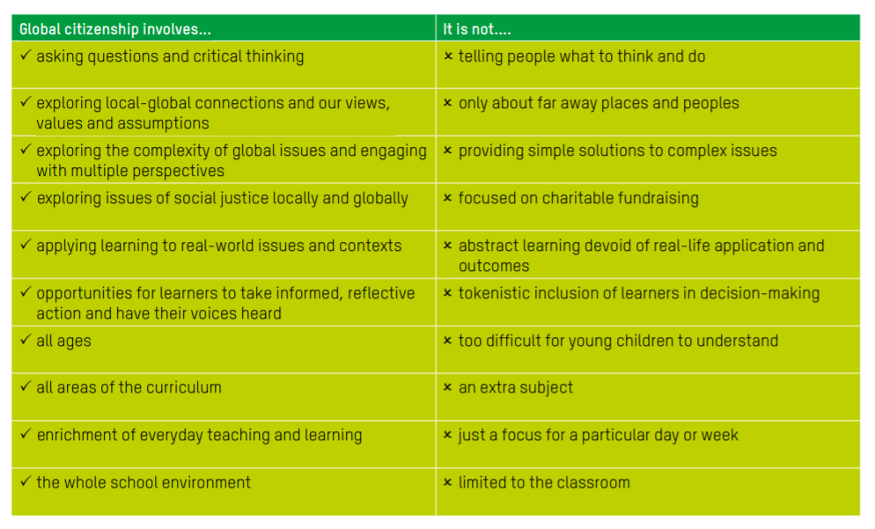

Slide 4
How to teach Global Citizenship?
What is the plan at Whitgift?
Pilot year of lessons in Year 6
1 lesson per week.
8 topics per year
4 weeks per topic
4 Environmental – Climate Change/Ocean Plastics/Recycling/ Deforestation
4 Equality – Hunger/Poverty/Water/Gender Equality

Slide 5
How to teach Global Citizenship?
What is the plan at Whitgift?
Year 7
No formal GC lessons but staff asked to include the themes and topics on the next slide as much as possible in lessons
Year 8
No formal GC lessons. The boys will conduct an Independent Project based on a GC topic. Staff are also asked to include the themes and topics on the previous slide as much as possible in lessons

Slide 6
How to teach Global Citizenship?
What is the plan at Whitgift?
Year 9
No formal GC lessons but staff asked to include the themes and topics on the next slide as much as possible in lessons

Slide 7
 | Term | Topic | Theme
Year 6 | M1 | Climate change | Environment
 | M2 | Hunger and Food Security | Equality
 | M3 | Ocean Plastics | Environment
 | L1 | Poverty (Absolute and UK) | Equality
 | L2 | Recycling | Environment
 | L3 | Water | Equality
 | T1 | Deforestation | Environment
 | T2 | Gender Inequality | Equality
Year 7 | M1 | EU Brexit. Nationalism and Identity | Diversity and Identity
 | M2 | Agriculture/Meat/Biodiversity | Environment
 | L1 | Democracy and the right to vote | Equality
 | L2 | Migration and Refugees | Diversity and Identity
 | T1 | Pollution - Air/Water | Environment
 | T2 | Life Expectancy and Health | Equality
Year 8 | M1 | Universal Declaration of Human Rights (UN) | Human Rights
 | M2 | Great Species Extinction + Biodiversity | Environment
 | L1 | Inequality within countries. Gini coefficient | Equality
 | L2 | Freedom of speech | Human Rights
 | T1 | Overpopulation | Environment
 | T2 | LGBT | Equality
Year 9 | M1 | Peace and Security - The UN | Peace and Justice
 | M2 | Energy Transition | Sustainability
 | L1 | Wetland Destruction | Environment
 | L2 | Crisis in Yemen | Peace and Justice
 | T1 | Water consumption | Sustainability
 | T2 | Melting Ice Sheets and Rising Sea Levels | Environment

Slide 8
Sustainable Development Goals
UN Initiative to achieve a better and more sustainable future for all.
They are a follow on from the generally very successful Millennium Development Goals that.
They are more far reaching, more ambitious and relate more to the sustainable management of the planet and equality.
They encourage people to ‘Think Global, Act Local’
The sustainable development goals form the framework of the GC curriculum. The UN has identified key areas that need addressing. As a school we would like to both understand why they are so important and also what we as global citizens can do to help achieve them.

Slide 9
https://www.ted.com/talks/michael_green_how_we_can_make_the_world_a_better_place_by_2030?language=en#t-51066

Slide 10
How to teach Global Citizenship
Can and should be embedded anywhere and everywhere in the curriculum.
Try to spot opportunities to include GC themes in lessons and schemes of work.
HOD’s and staff asked to keep a log of examples so we can build up a bank of ideas and best practice. Each department will have a designated representrative
Some ideas:
Form time – highlight world days or news stories
Lessons:

Slide 11
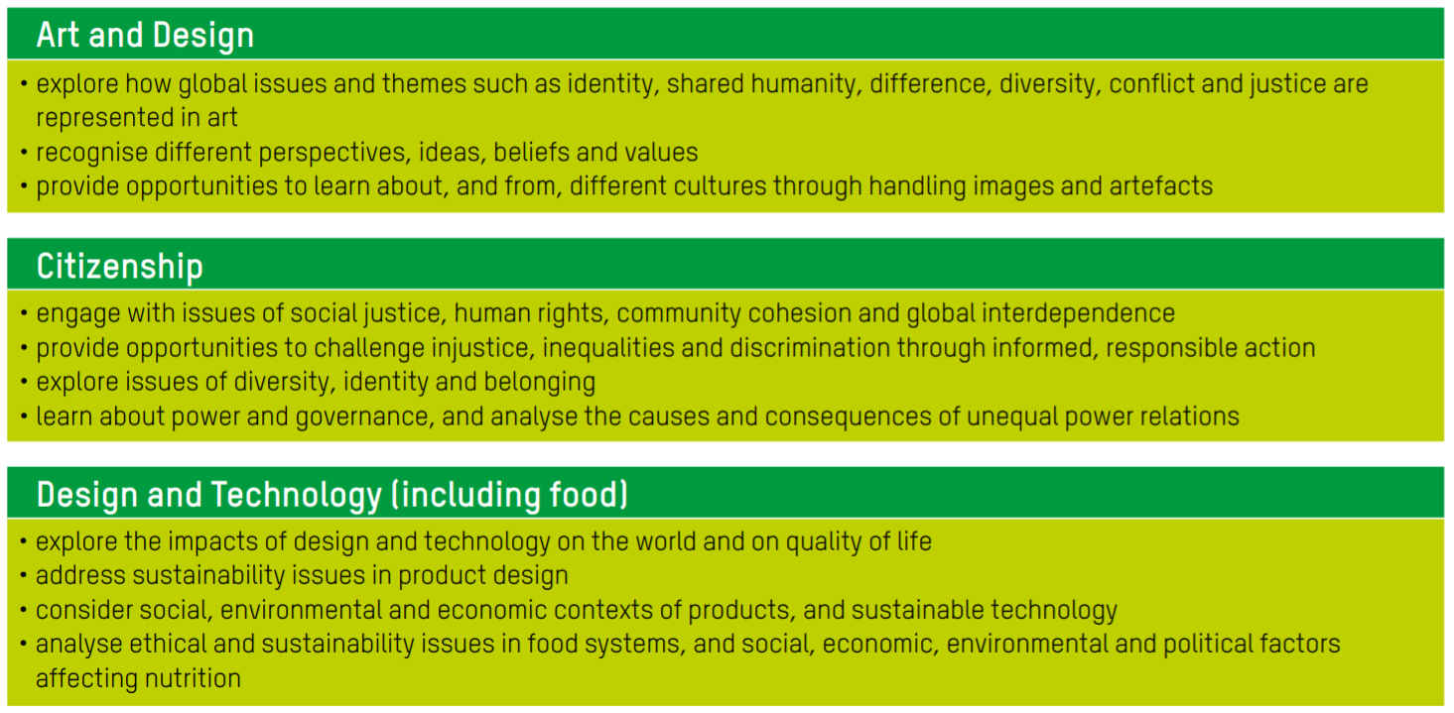

Slide 12
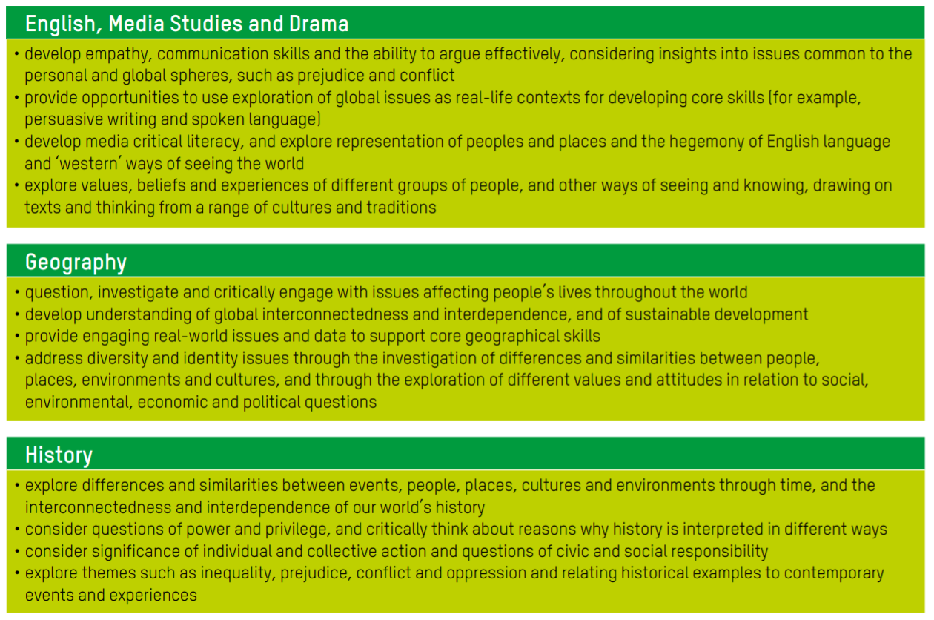

Slide 14
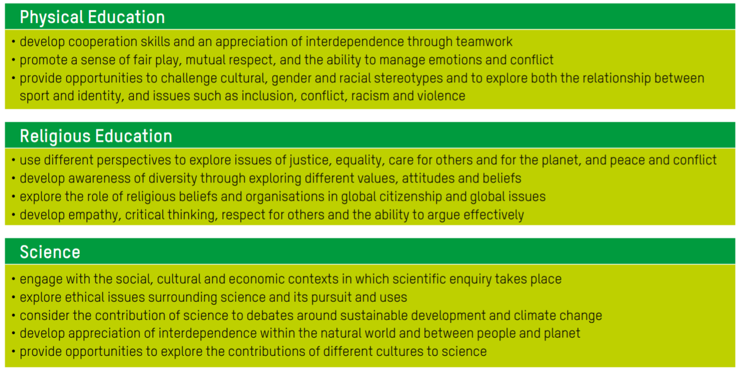

Slide 15
Over to you!
What do we think about the plans?
What ideas do people have?
What is missing?
What key issues need addressing?
Any suggestions greatly appreciated

Slide 16
What key issues should we include in future GC schemes of work and lessons?
_________________________________________________________________________________________________________________________________________________________________________________________________________________________________________________________________________________________________________________________________________________________________________________________________
How can the boys engage in the local community and beyond to take action? ‘Think global, Act Local’
_________________________________________________________________________________________________________________________________________________________________________________________________________________________________________________________________________________________________________________________________________________________________________________________________________________________________________________________________________________________________________________________________________________________________________________________________________________________________________________________________________________________
What does Global Citizenship mean to people?
_______________________________________________________________________________________________________________________________________________________________________________

