Slide 1
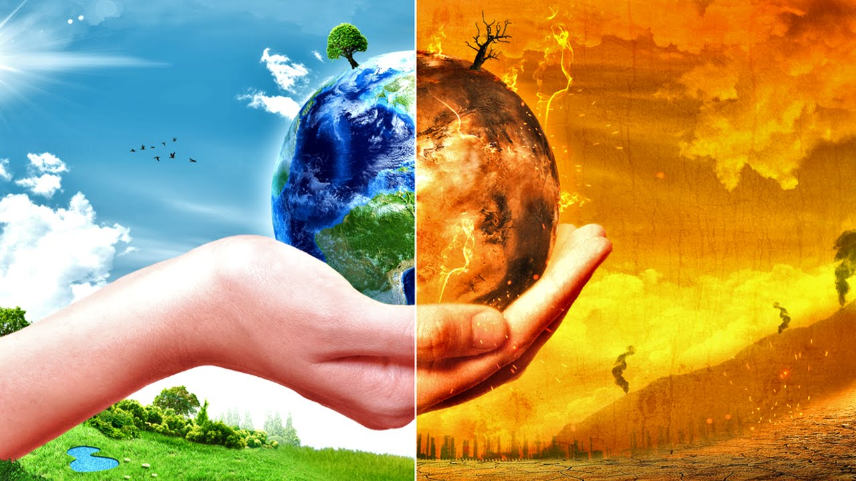
Global Citizenship Theme: Environment Topic: Climate Change
Watch the following documentary
https://www.youtube.com/watch?v=q9WyLPgyuqo
Climate Change: The Facts | FULL EPISODE - BBC

Slide 2
Global Citizenship Theme: Environment Topic: Climate Change
As you watch the documentary, add notes underneath the following headings
Problems: What are the human actions that are creating the problem?
Solutions: What examples are provided that offer hope and optimism for the future?
Feelings: Make a note of all the feelings that you have during the documentary.
Problems
Solutions
Feelings

Slide 3
Global Citizenship Theme: Environment Topic: Climate Change
Outcome/Follow-up work
Over to you!
What do you think about climate change?
How do you feel?
What are your opinions?
How do you want to express your opinion/views?
Do you feel empowered to act?
https://www.youtube.com/watch?v=VFkQSGyeCWg
Before we can vote, there are still plenty of ways to express our thoughts and feelings about global issues. This is what Greta Thunberg decided to do

Slide 4
Global Citizenship
Letters (MP/HM/Supermarkets)
Speeches (inspired by Greta Thumberg)
Year 6 blog
Poem
Artwork/Sketch/Graphic
Poster
Newspaper front cover
School article - year 6 newsletter
Debate
Group Presentation
Mini play/Drama
Roleplay
Discussion and debate
Ranking exercises
Outcomes:
(each topic, you will be able to chose how you would like to represent what you have learnt. This will be)

