Slide 1
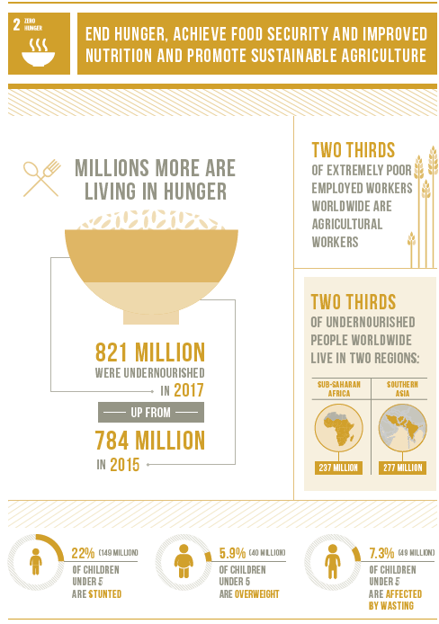
Global Citizenship Theme: Equality Topic: Hunger and Food Insecurity SDG: Goal 2 – Zero Hunger
Task:
Read and stick in the sheet provided in your book.

Slide 2
Hunger
An estimated 821 million people were undernourished in 2017.
The majority of the world’s hungry people live in developing countries, where 12.9 per cent of the population is undernourished.
Sub-Saharan Africa remains the region with the highest prevalence of hunger, with the rate increasing from 20.7 per cent in 2014 to 23.2 per cent in 2017.
In sub-Saharan Africa, the number of undernourished people increased from 195 million in 2014 to 237 million in 2017.
Poor nutrition causes nearly half (45 per cent) of deaths in children under five – 3.1 million children each year.
149 million children under 5 years of age—22 per cent of the global under-5 population—were still chronically undernourished in 2018.

Slide 3
Food security
Agriculture is the single largest employer in the world, providing livelihoods for 40 per cent of today’s global population. It is the largest source of income and jobs for poor rural households.
500 million small farms worldwide, most still rainfed, provide up to 80 per cent of food consumed in a large part of the developing world. Investing in smallholder women and men is an important way to increase food security and nutrition for the poorest, as well as food production for local and global markets.
Since the 1900s, some 75 per cent of crop diversity has been lost from farmers’ fields. Better use of agricultural biodiversity can contribute to more nutritious diets, enhanced livelihoods for farming communities and more resilient and sustainable farming systems.
If women farmers had the same access to resources as men, the number of hungry in the world could be reduced by up to 150 million.
840 million people have no access to electricity worldwide – most of whom live in rural areas of the developing world. Energy poverty in many regions is a fundamental barrier to reducing hunger and ensuring that the world can produce enough food to meet future demand.

Slide 4
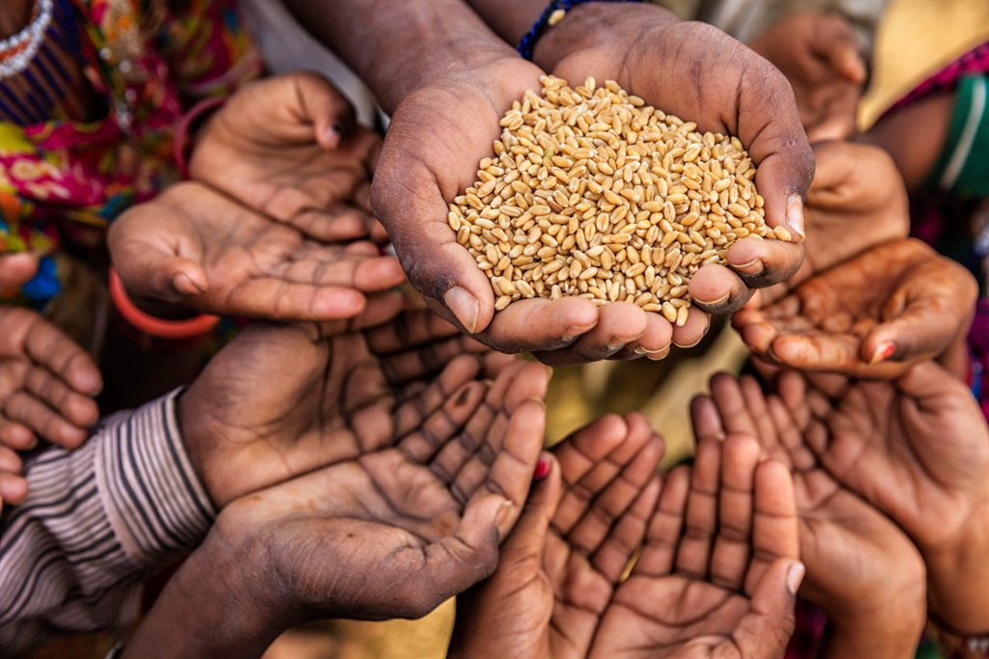
Global Citizenship Theme: Equality Topic: Hunger and Food Insecurity SDG: Goal 2 – Zero Hunger
Task:
Choose one of the facts outlined on your information sheet which you find the most interesting or concerning.
Write it out in your book in your own writing
You then need to write a paragraph explaining how you feel about what you have written. What emotions does it create?

Slide 5
Sustainable Development Goals – What are the United Nations are planning to achieve?
What is it like living with hunger?
Watch the following documentary set in Ethiopia showing what it is like for some of the 821 million people who live in food insecurity or who are malnourished.
https://www.youtube.com/watch?v=SWFcgZriEHw
https://online.clickview.co.uk/libraries/categories/10769335/videos/10772030/living-with-hunger

Slide 6
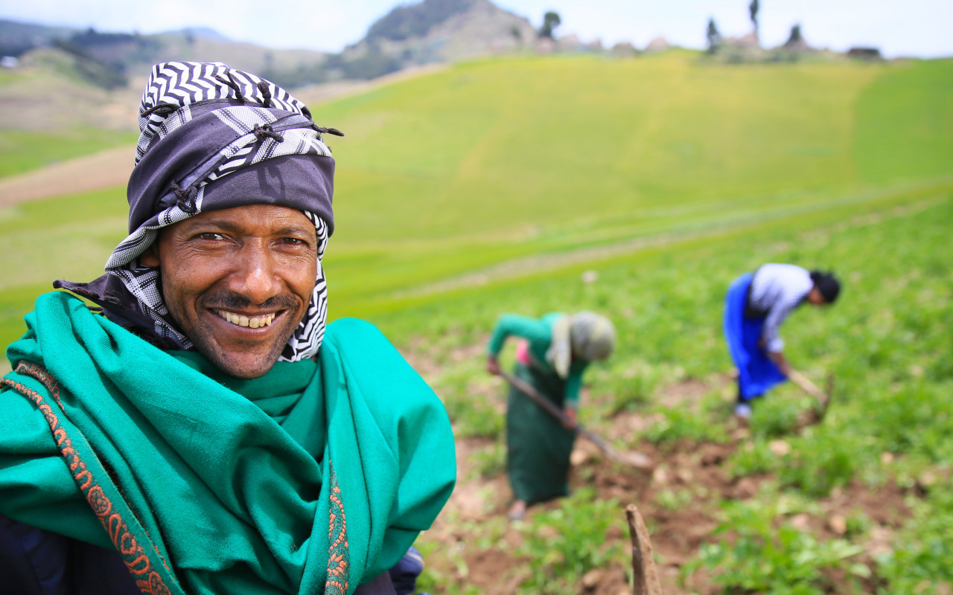
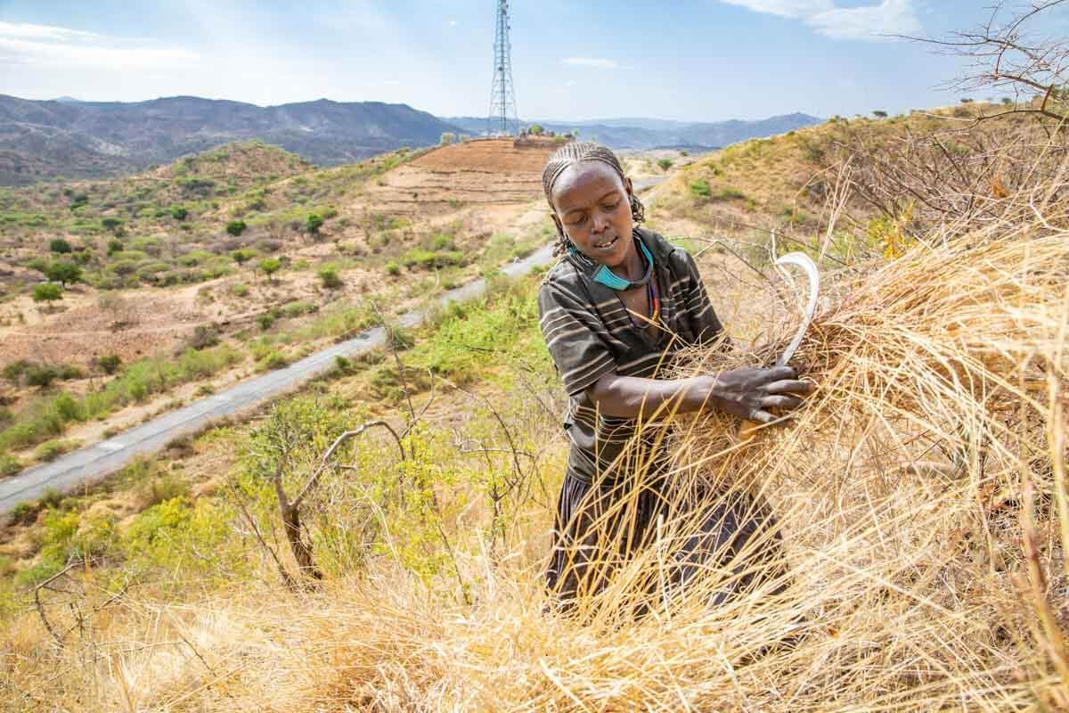
Global Citizenship Theme: Equality Topic: Hunger and Food Insecurity SDG: Goal 2 – Zero Hunger
Whist watching the documentary, you need to do the following:
Write individual words on one page of your book. These words should be the thoughts and opinions that come into your head as you watch the documentary.
They could be words such as:
Tired, hard-work, illness etc

Slide 7
Global Citizenship
Letters (MP/HM/Supermarkets)
Speeches (inspired by Greta Thumberg)
Year 6 blog
Poem
Artwork/Sketch/Graphic
Poster
Newspaper front cover
School article - year 6 newsletter
Debate
Group Presentation
Mini play/Drama
Roleplay
Discussion and debate
Ranking exercises
Outcomes:
(each topic, you will be able to chose how you would like to represent what you have learnt. This will be)

Slide 8
Fair trade - https://www.fairtrade.org.uk/What-is-Fairtrade/What-Fairtrade-does Food Aid - https://www.wfp.org/overview UN School feeding program - https://www.wfp.org/school-meals AGRA - https://agra.org/ One acre fund - https://oneacrefund.org/

